Slide 2
Constraints in SQL
column-level constraint:we can define constraint only for specific column only
table-level constraint:we can define constraint for multiple columns

Slide 3
Column-level constraint
NOT NULL
PRIMARY KEY
UNIQUE
FOREIGN KEY
CHECK

Slide 4
Table-level constraint
PRIMARY KEY
UNIQUE
FOREIGN KEY
CHECK

Slide 5
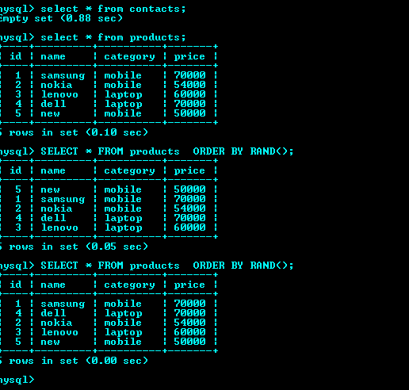
Sql select random
SELECT column FROM table
ORDER BY RAND ( ) ;

Slide 6
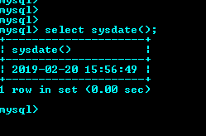
SYSDATE() Function
The SYSDATE() function returns the current date and time.

Slide 7
View In SQL
Views are used for security purpose in databases,views restricts the user from viewing certain column and rows means by using view we can apply the restriction on accessing the particular rows and columns for specific user

Slide 8
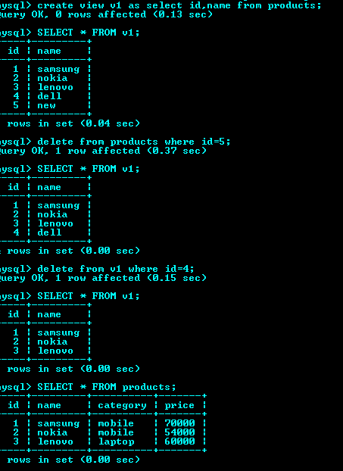

Slide 9
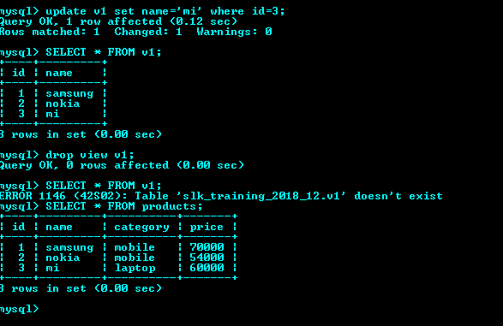

Slide 10
Difference between varchar and varchar2
Varchar | Varchar2
1) Varchar can identify NULL and empty string separately. | 1) Varchar2 cannot identify both separately. Both considered as same for this.
2) Varchar can store minimum 1 and maximum 2000 bytes of character data. | 2) Varchar2 can store minimum 1 and maximum 4000 bytes of character data.
3) Allocate fixed size of data irrespective of the input. Ex: We defined varchar (15) and entered only 10 characters. But it allocates space for entire 15 characters. | 3) Allocate variable size of data based on input. Ex: We defined varchar2 (15) and entered only 10 characters. Then varchar2 will allocate space for 10 characters only but not for 15.
4) For varchar data, extra spaces are padded to the right side. | 4) For varchar2 extra spaces will be truncated.
5) Varchar is ANSI Sql standard | 5) Varchar2 is Oracle standard
6) Varchar definition may change in future. | 6) Varchar2 definition will not change. It is standard.
7) Varchar is an external datatype. | 7) Varchar2 is an internal datatype.

Slide 11
Analytic functions in sql
RANK
DENSE_RANK
FIRST and LAST

Slide 12
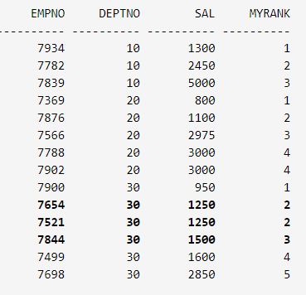
DENSE_RANK
SELECT empno, deptno, sal, DENSE_RANK() OVER (PARTITION BY deptno ORDER BY sal) AS myrank FROM emp;

Slide 13
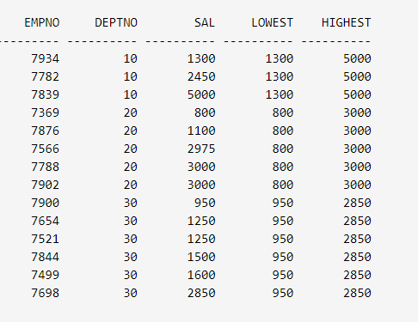
FIRST and LAST
SELECT empno, deptno, sal, MIN(sal) KEEP (DENSE_RANK FIRST ORDER BY sal) OVER (PARTITION BY deptno) AS lowest, MAX(sal) KEEP (DENSE_RANK LAST ORDER BY sal) OVER (PARTITION BY deptno) AS highest FROM emp ORDER BY deptno, sal;

Slide 14
Decode in sql
DECODE is a function in Oracle and is used to provide if-then-else type of logic to SQL
Syntax:
DECODE ( expression, search, result [, search, result]... [,default] )
The expression is the value to compare. Many combinations of search and result can be supplied. Search is compared against the expression, and if it is true, then result is returned.
SELECT DECODE (Store_Name, 'Los Angeles', 'LA', 'San Francisco', 'SF', 'San Diego', 'SD', 'Others') Area, Sales, Txn_Date FROM Store_Information;

Slide 15
Thank You

